Slide 1
Shoes Sorter
Wenhao Li, Yuhao Wang, Yujie Hua, Yuan Zhang
Notes:
Hello everyone, we are the shoe sorter team, I am Wenhao Li, this is Yuhao Wang, Yujie Hua, and Yuan Zhang. Today, we are going to give you a general presentation, summarizing all main contents of our project for this course.

Slide 2


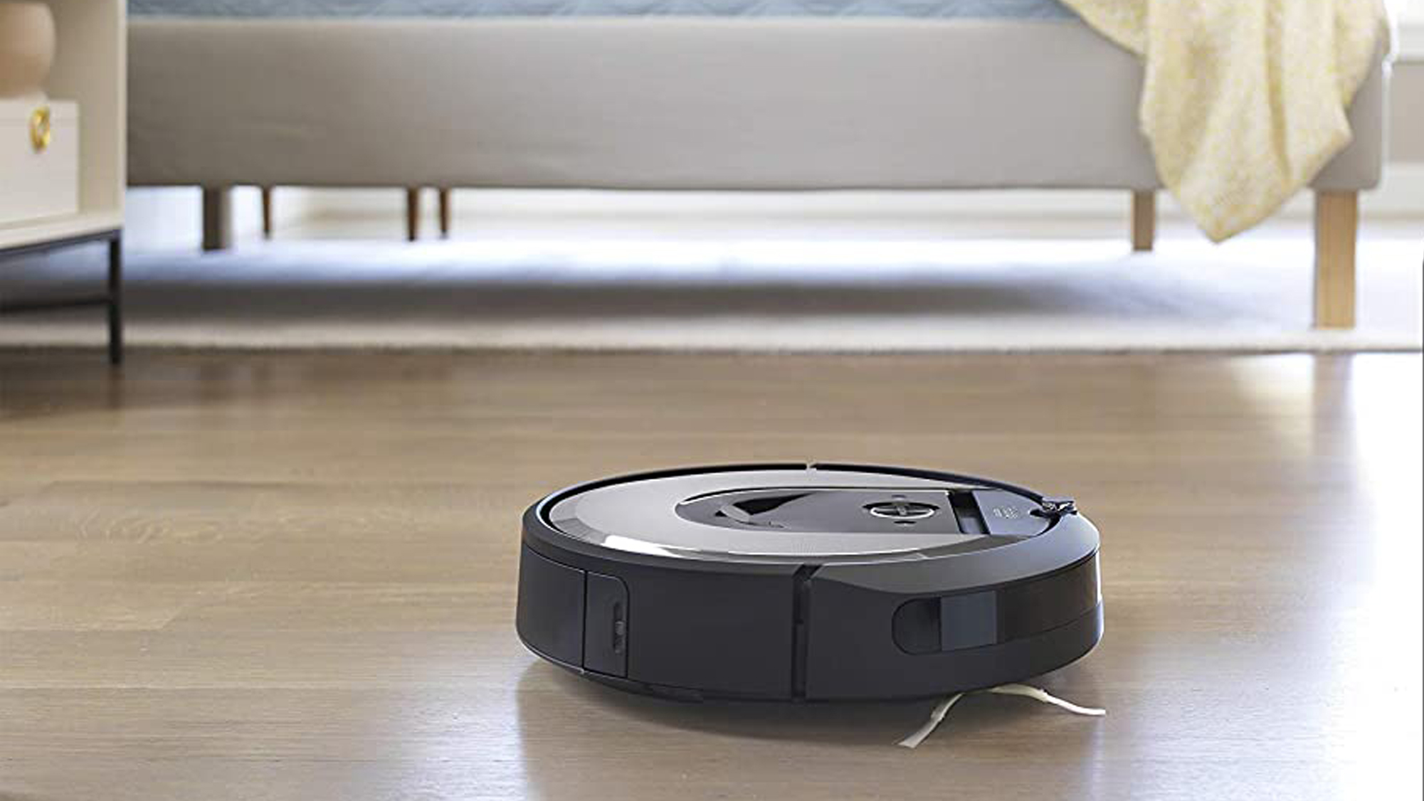
AI Application in Our Life...
Notes:
First of all, as you can see in your life, AI applications are widely used. In your cellphones, there are AI using voice and face recognitions to improve the users’ experience and efficiency. When you drive a vehicle, AI techniques are designed to help you improve your driving experience, and for instance, the light adjustment can largely improve the safety of driving. Also at home, you may use cleaning robots to sweep the floor using AI. So basically, all these applications help us to improve our life experience and efficiency.

Slide 3
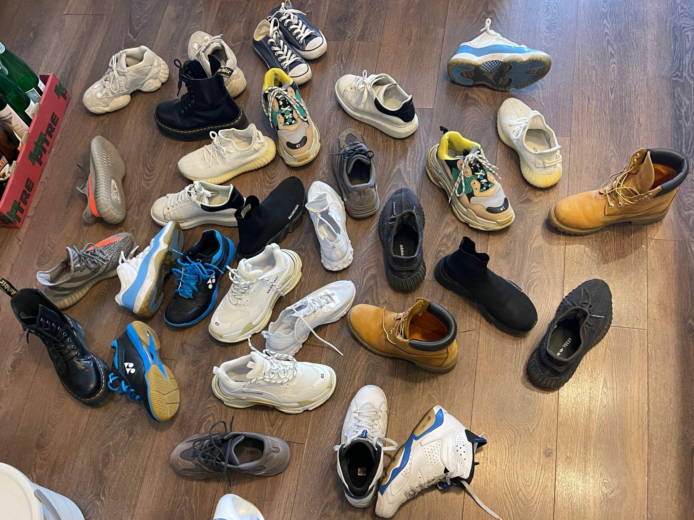
Now imagine that…
Notes:
Now imagine that after a whole day’s work or study, you go back home, taking off your shoes and clothes, and heading straight to your bed. It will be really great if you have a robot helping you to clean up the messy living room.
So, we came up with this idea of designing an automated robot that can sort the shoes and place them in order on your shoe rack.

Slide 4
Main Tasks
Simutaniously Localization and Mapping (SLAM)
Shoe Detection & Pairing
Generating Collision-free Paths and Optimization
Grasping and Placing Shoes on the Shoe Rack
Notes:
There are 4 tasks that this robot is going to do. The first one is using simultaneous localization and mapping technique, which is SLAM in short, to build up a room map. This map is going to be the reference of the path planning portion for the AI agent. After that, image processing techniques are used to determine where the shoes are, and which part of the shoe can be referred to as the gripping point. Also, using another algorithm, shoes are paired, and the paired data can be stored for implementation of shoe sorting process later on. Thirdly, the agent will generate a collision-free path and optimize that path in real-time adjustment during its movement. The last task is grasping the shoe and place it on the shoe rack accordingly. This process is simplified into the case of grasping an object from a given point and place it to the targeted destination. Each of those 4 tasks is going to be shown with a short demo.

Slide 5
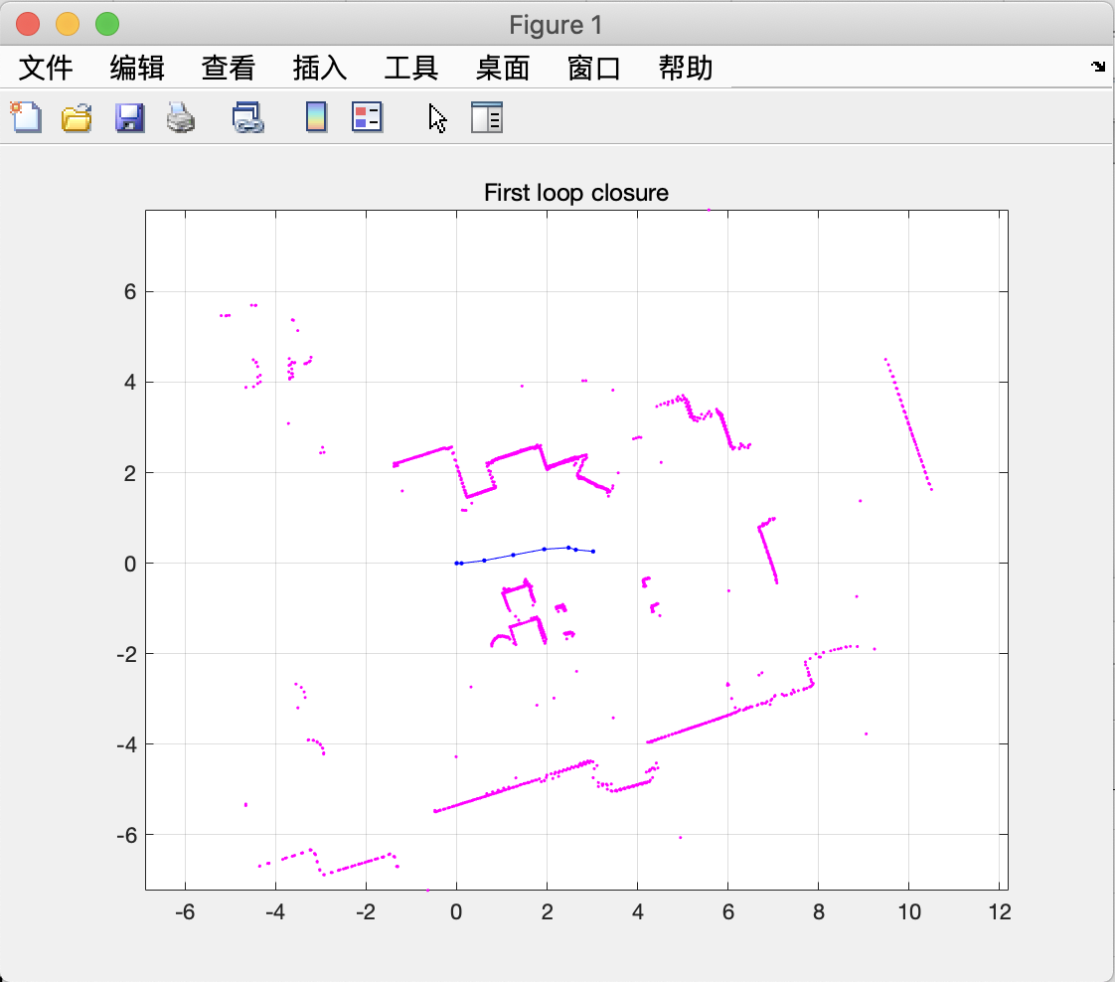
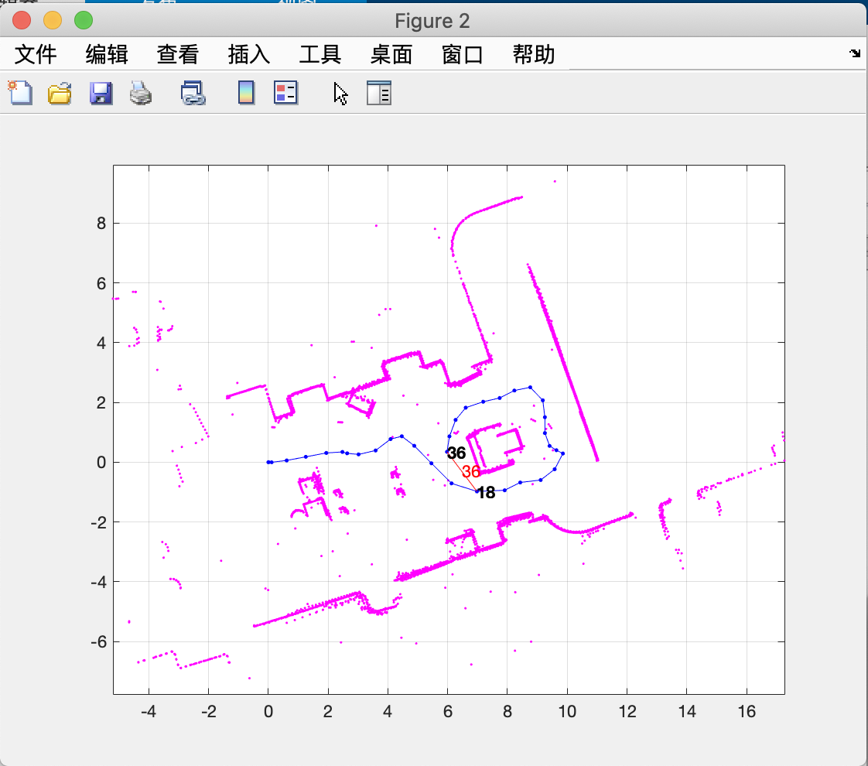
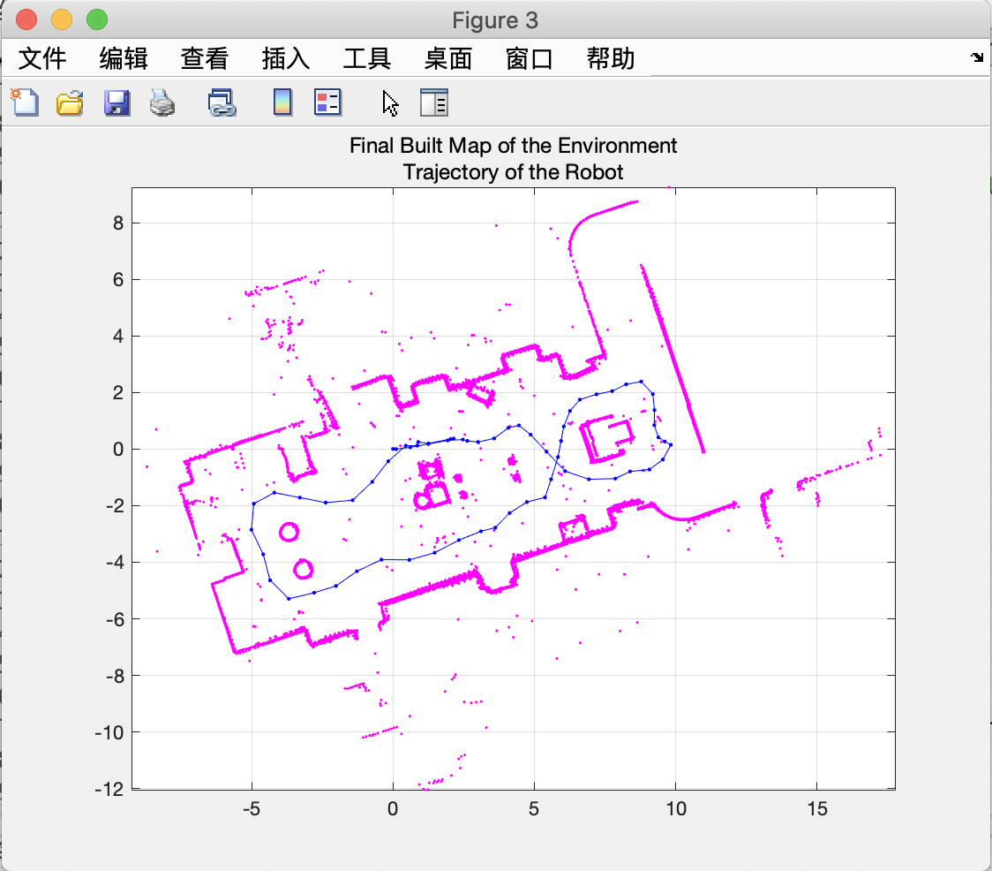
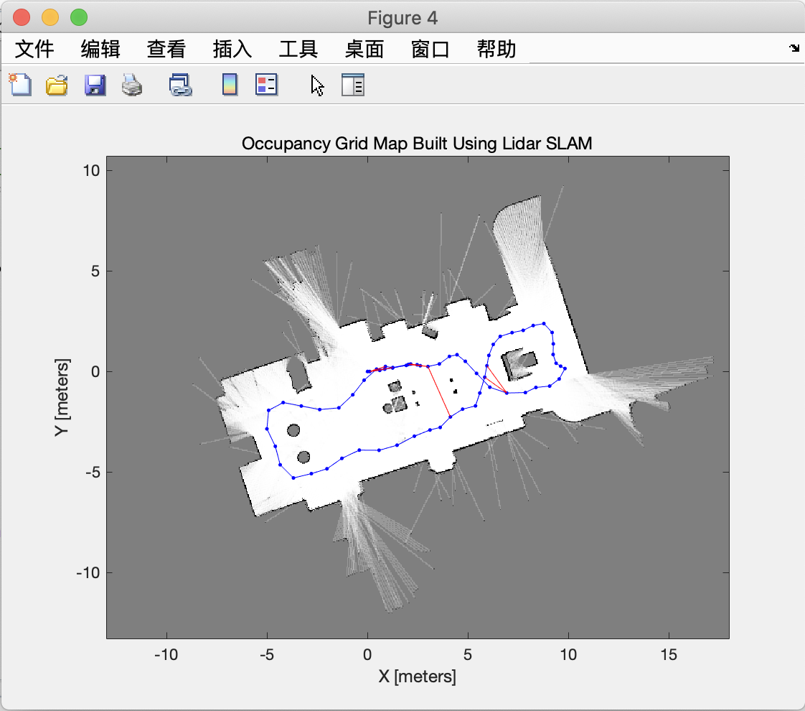
Simutaniously Localization and Mapping (SLAM)
Adapted from: https://www.mathworks.com/help/nav/ug/implement-simultaneous-localization-and-mapping-with-lidar-scans.html
Notes:
Okay, now let me talk about SLAM. First, in our project, we didn’t really use SLAM to generate a real dataset because we do not have a Lidar sensor to collect the environment data. However, we suggested this idea of building up the room map using the SLAM technique to enable further process. In the real case if we are able to have a sensor, we will use it to generate useful data ourselves. To use SLAM, we will first let the agent browse the environment along the walsl and stop until a trajectory loop has been formed.

Slide 6
Simutaniously Localization and Mapping (SLAM)
Loop closure
Feature alignment
Reduce encoder error
Control the number of loops
Adapted from: https://www.mathworks.com/help/nav/ug/implement-simultaneous-localization-and-mapping-with-lidar-scans.html
Notes:
A loop closure is needed to conduct feature alignment, and this process is used to reduce the effect of encoder error. Ideally, running more loops of different trajectories will give us a much more reliable environment map. However, in the real case, it also brings a higher risk of gaining incorrect associations that will lead to the situation of have a less reliable map at the end. Thus, we need to do a trade-off to maximize the reliability of the result.

Slide 7
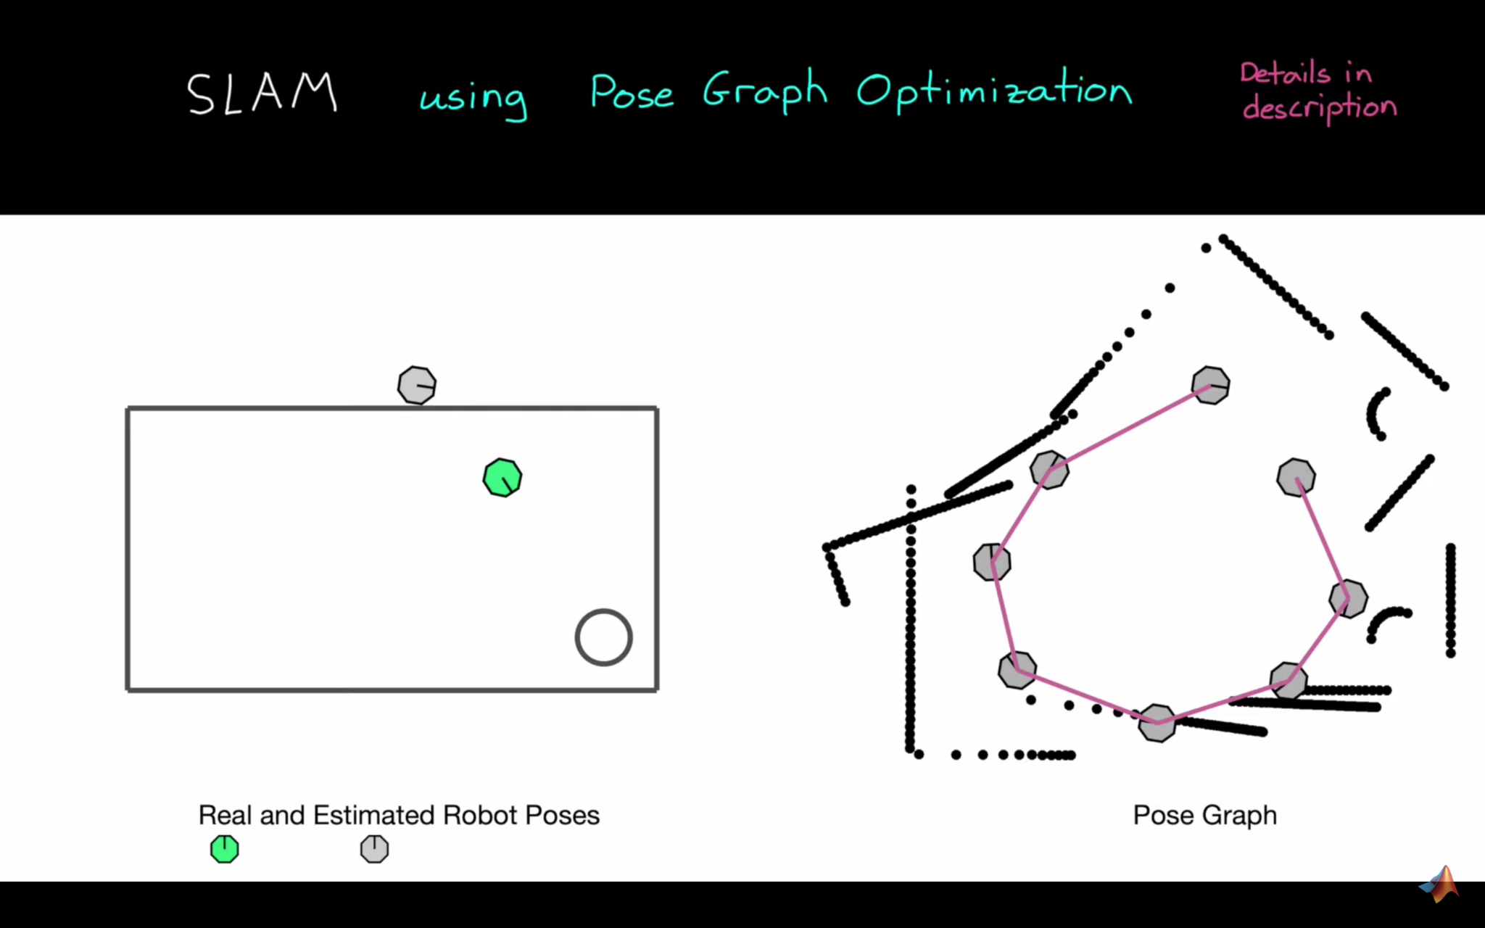
Simutaniously Localization and Mapping (SLAM)
Loop closure
Feature alignment
Reduce encoder error
Control the number of loops
Adapted from: https://www.youtube.com/watch?v=saVZtgPyyJQ&t=856s
(Understanding SLAM Using Pose Graph Optimization | | Autonomous Navigation, Part 3)
Notes:
In the video of understanding SLAM using pose graph optimization, this process has been talked about, and I have taken a screen shot of this video that explains the feature alignment part. The idea of that process is to adjust the position gap when a same feature is detected.
And that’s it for SLAM. Now I will hand this over to Yuhao for image processing part.

Slide 8
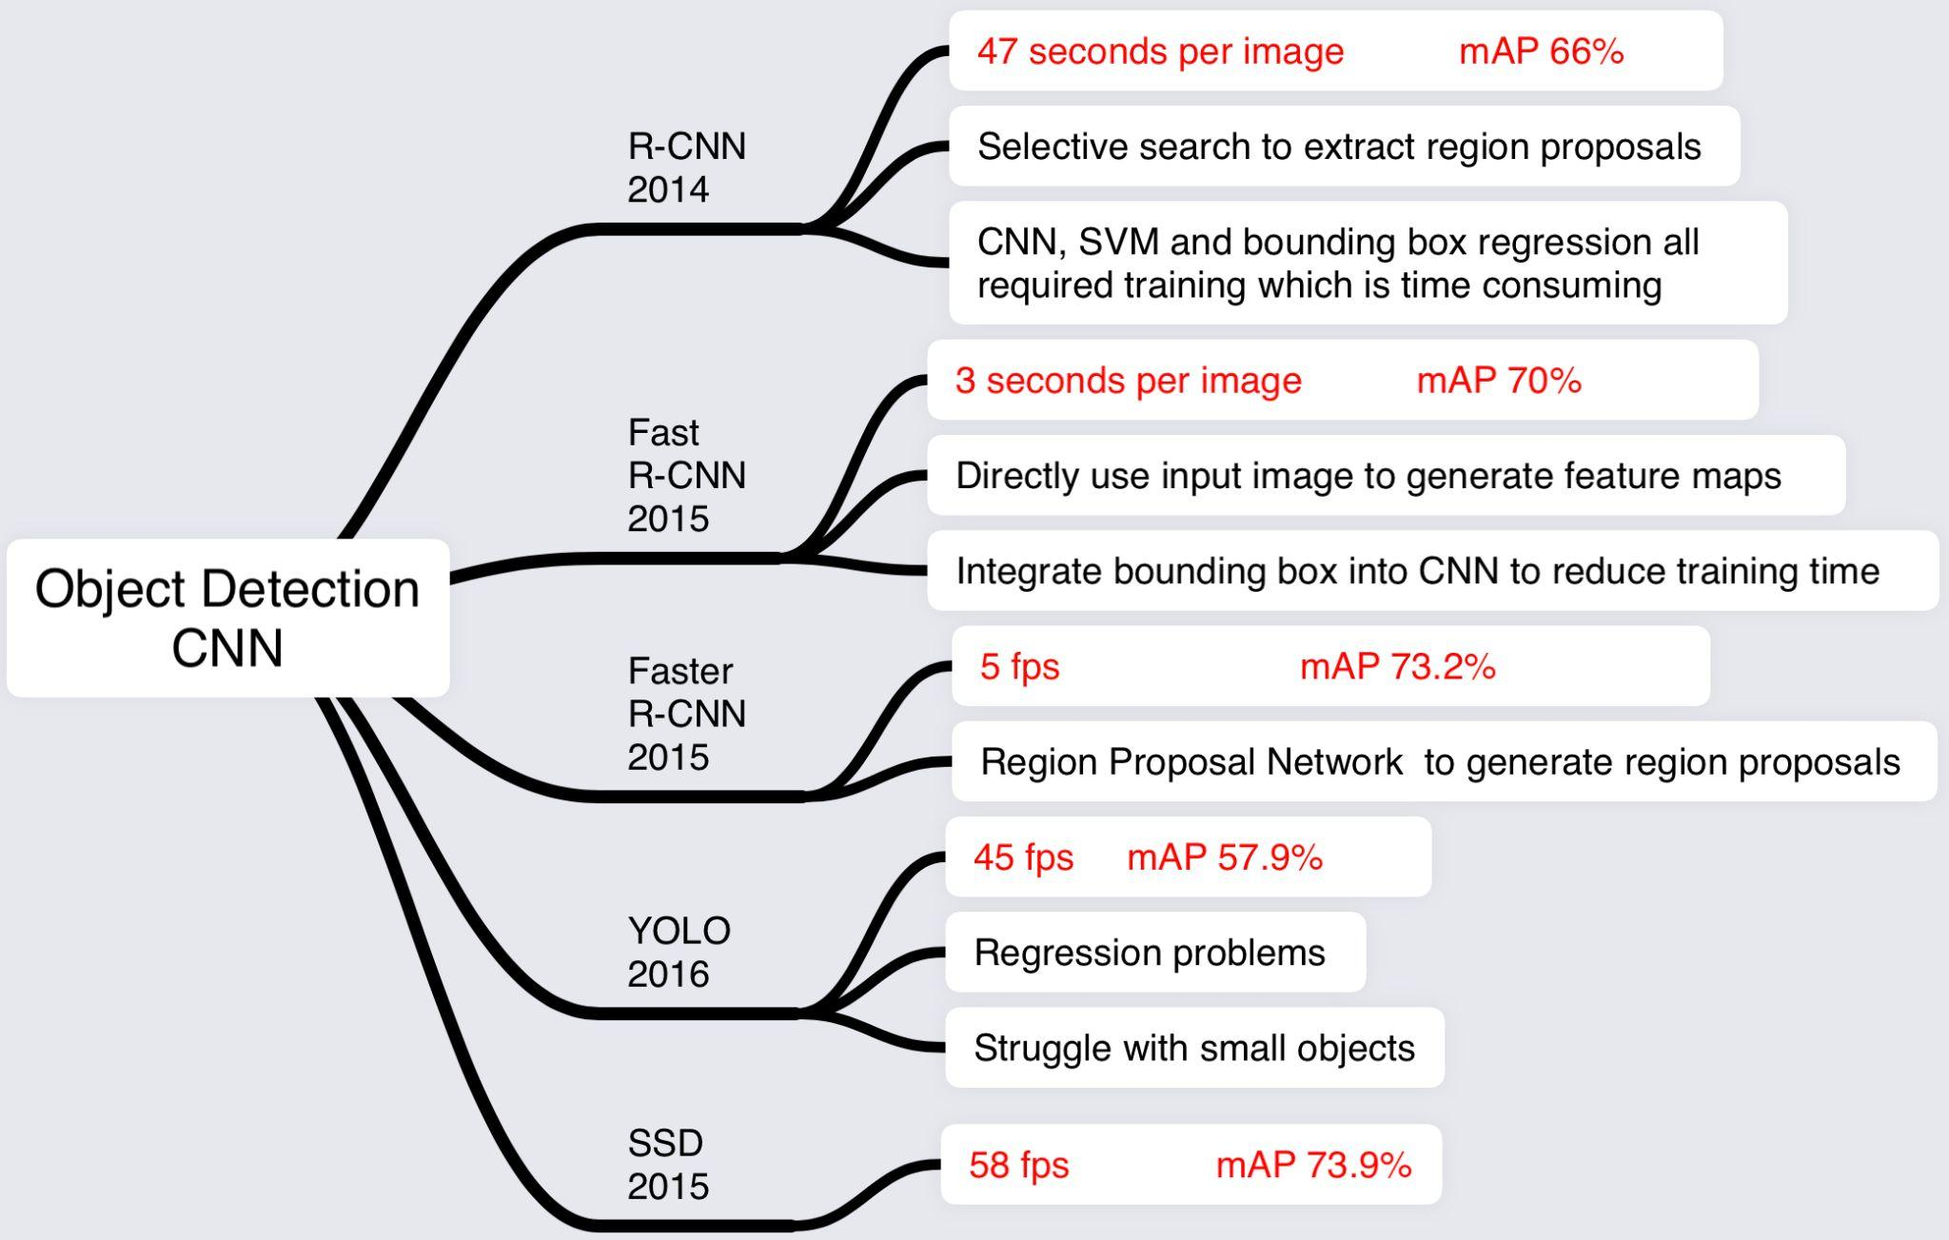
Shoe Detection YOLO v3

Slide 9
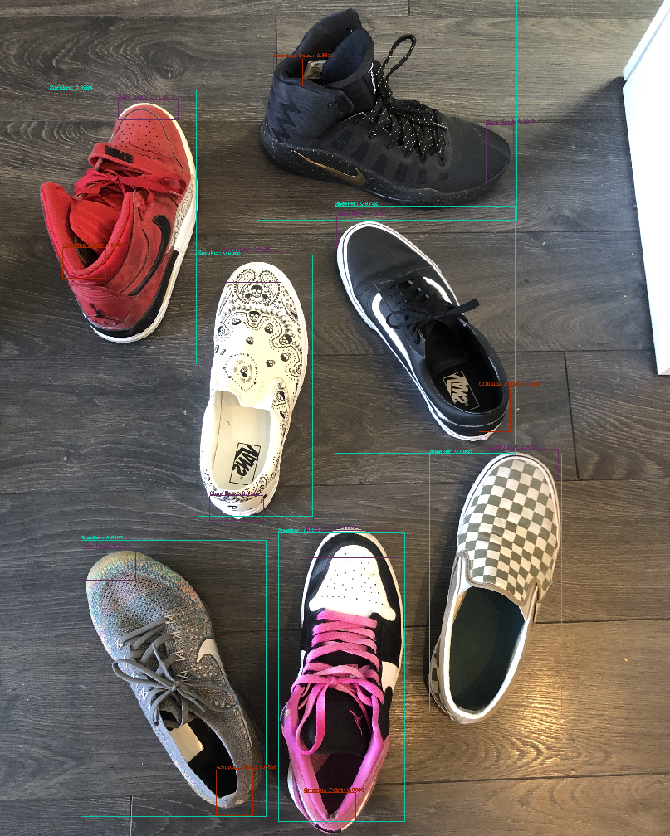
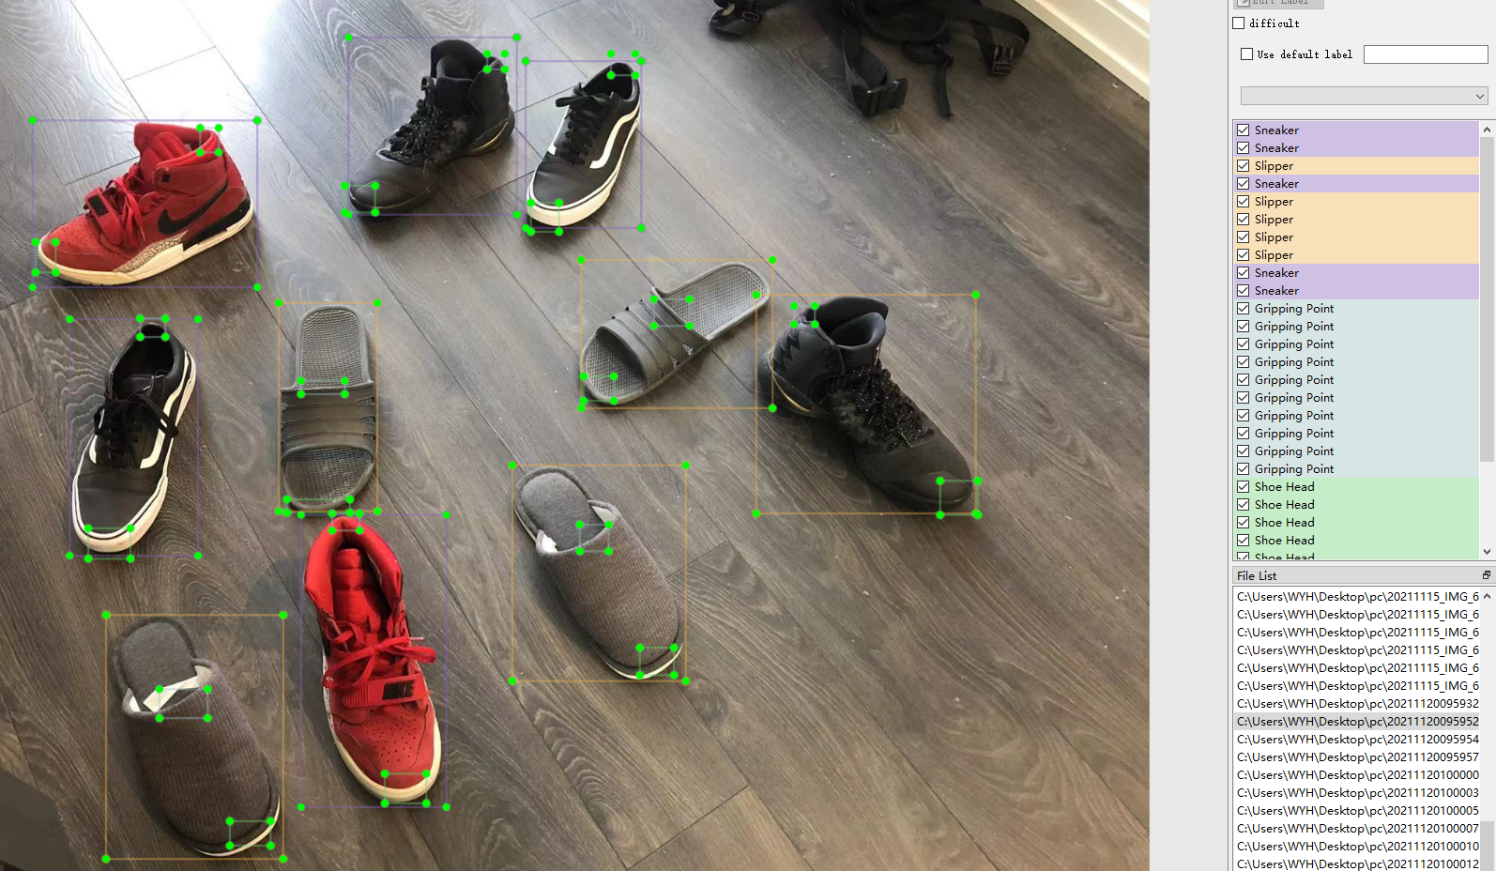
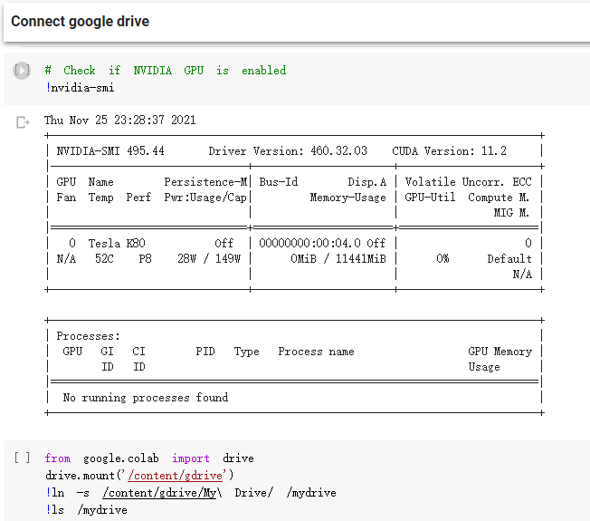
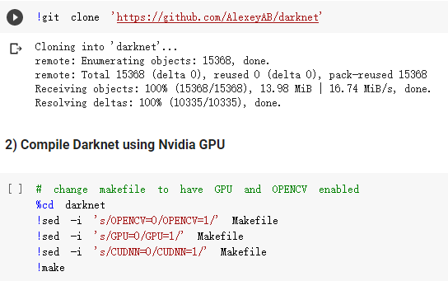
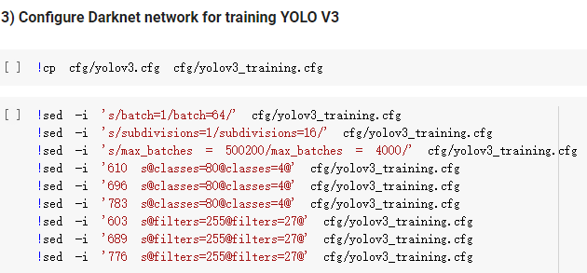
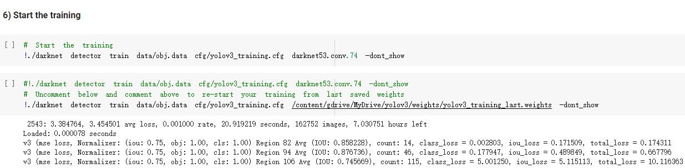
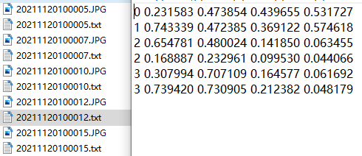

Slide 10
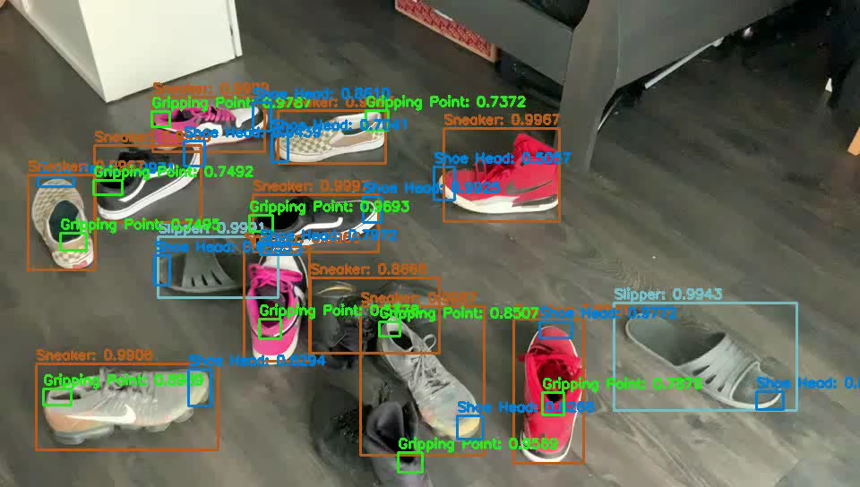

Slide 11
Shoe Pairing SIFT Algorithm
Scale Invariant Feature Transform
Search key locations in scale space by searching for maxima or minima locations in difference-of-Gaussian function
Generate feature vectors SIFT keys
Use a nearest-neighbour approach on SIFT keys to identify candidate object models.

Slide 12
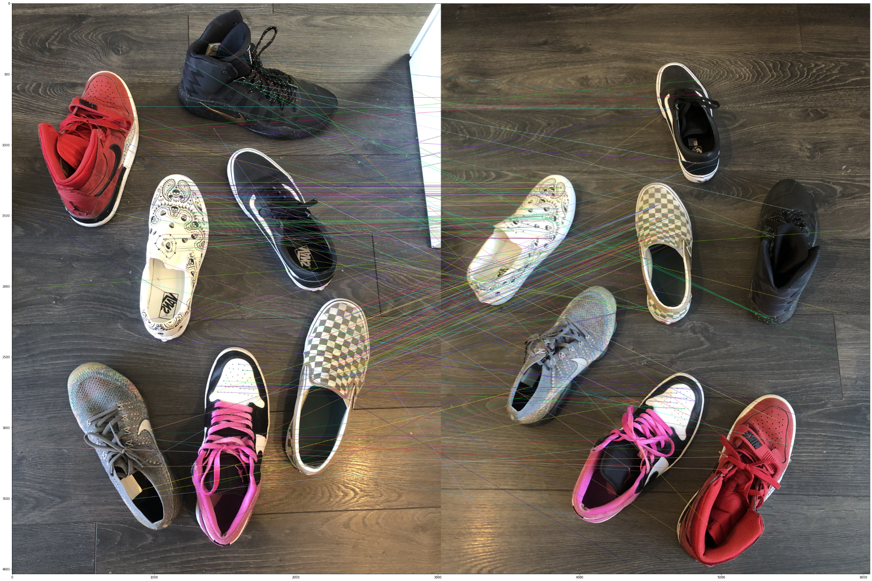

Slide 13
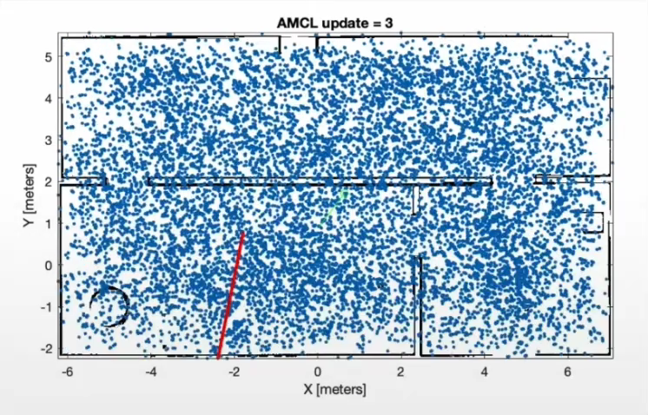
Localization
Markov localization
Monte Carlo localization
Kalman filter localization

Slide 14
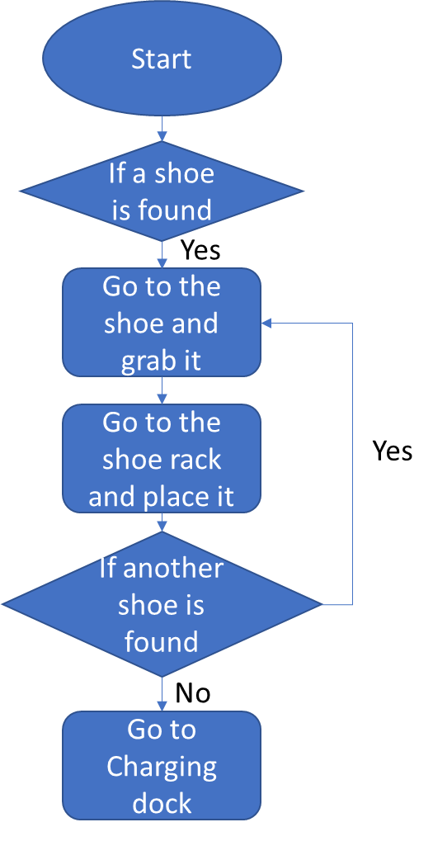
Path Planning
A*
PRM
RRT*

Slide 15
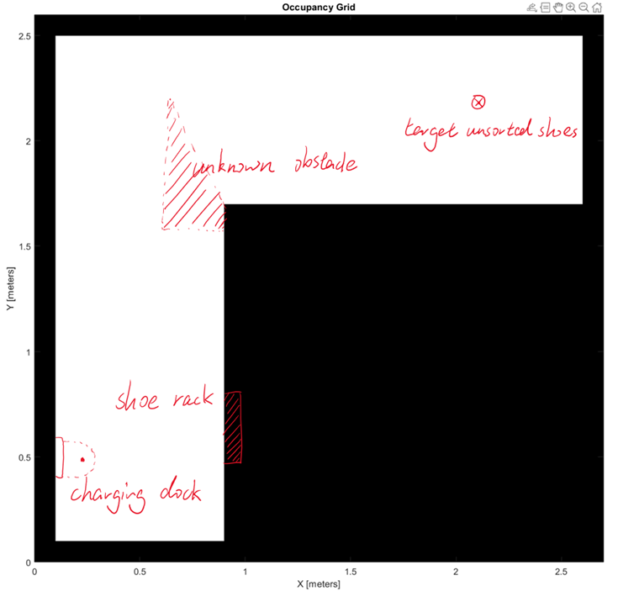
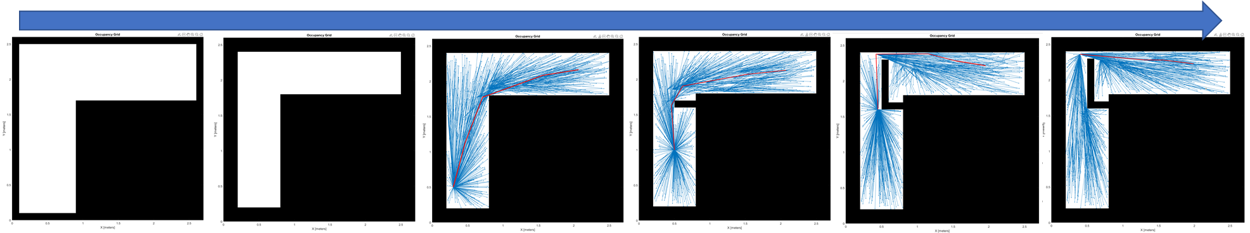
Path Planning
A*
PRM
RRT*

Slide 16
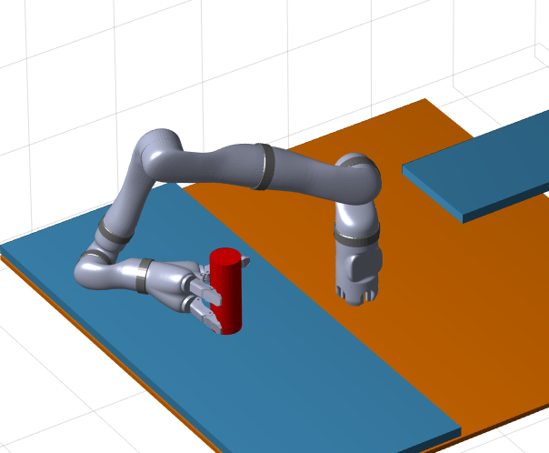
Robot Arm Motion Planning
* The shoe is represented by the cylinder

Slide 17
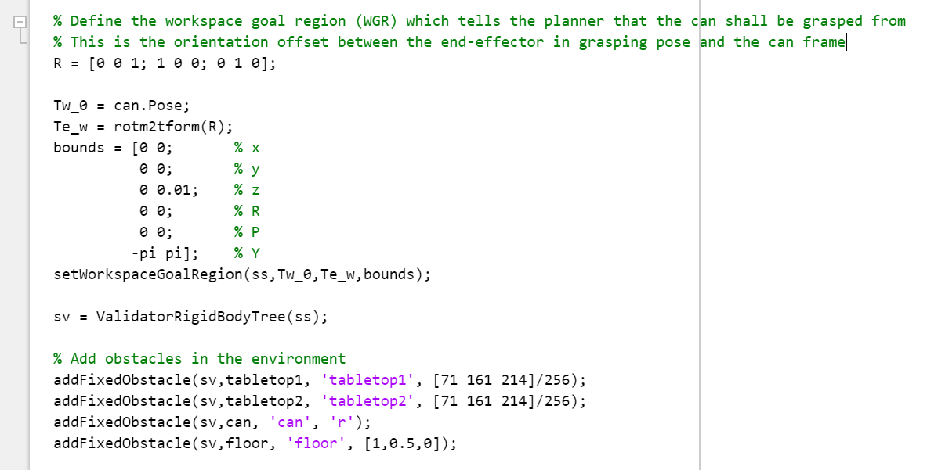
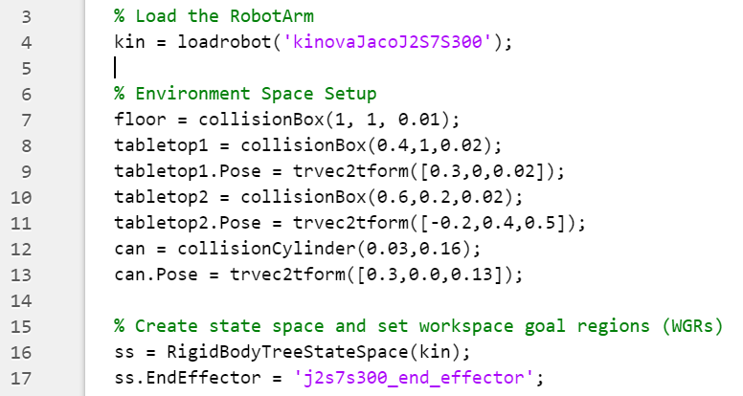
Robot Arm Motion
Environment/Arm State Space
Move Motion Plan
Grasp Motion

Slide 18
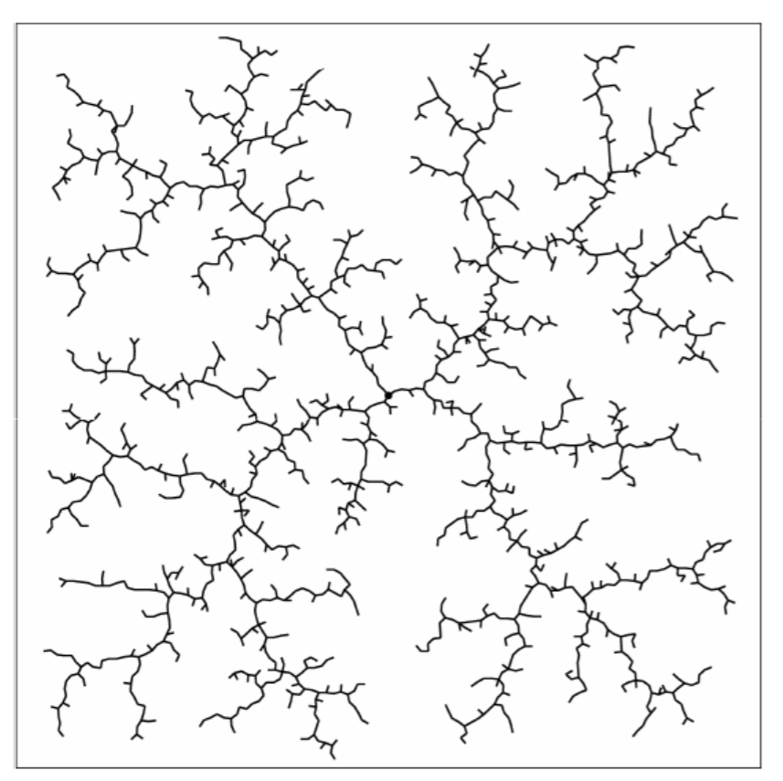
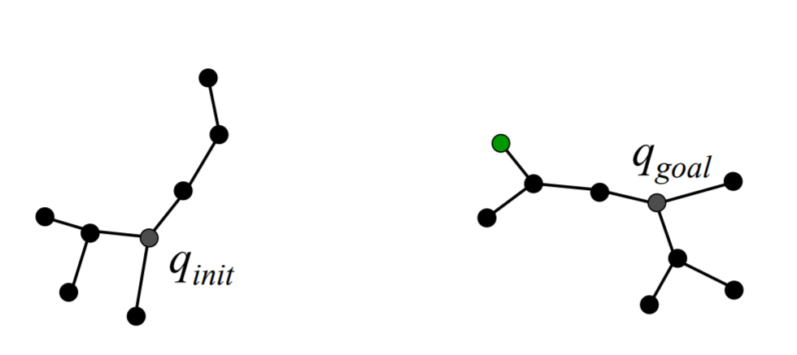
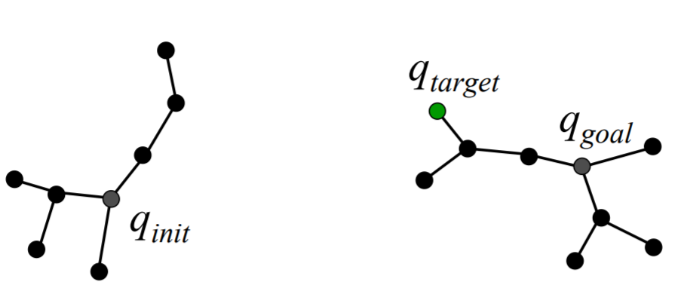
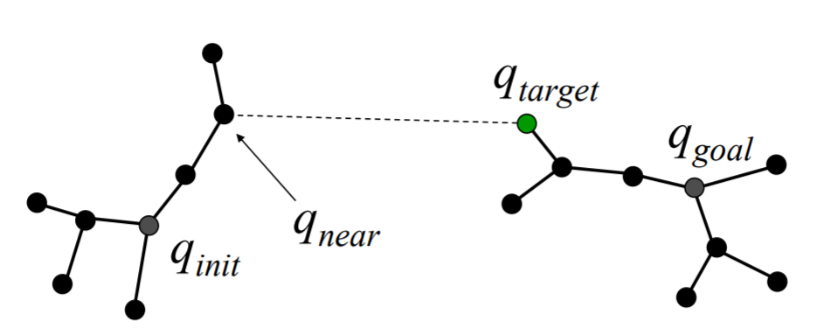
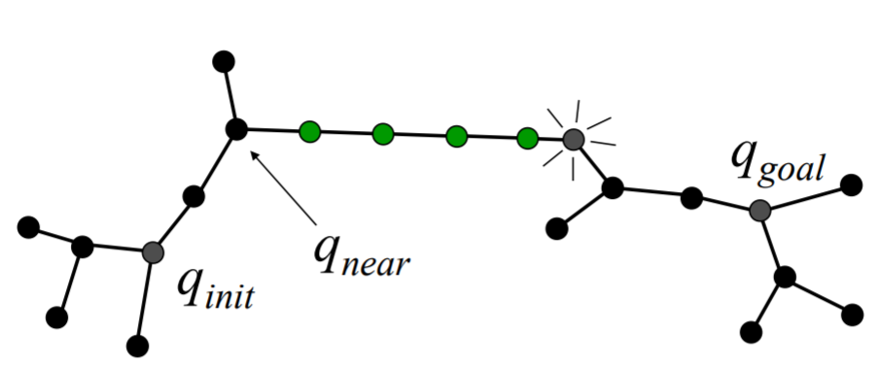
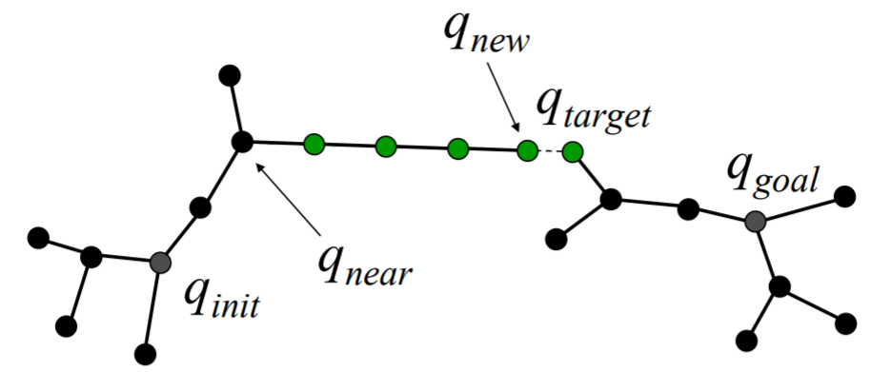
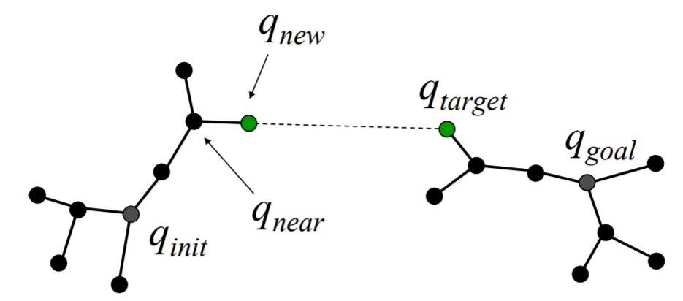
Rapidly-exploring Random Tree path planner (RRT)
Environment/Arm State Space
Move Motion Plan
Grasp Motion
[2] RI 16-735, Howie Choset with Images from James Kuffner

Slide 19
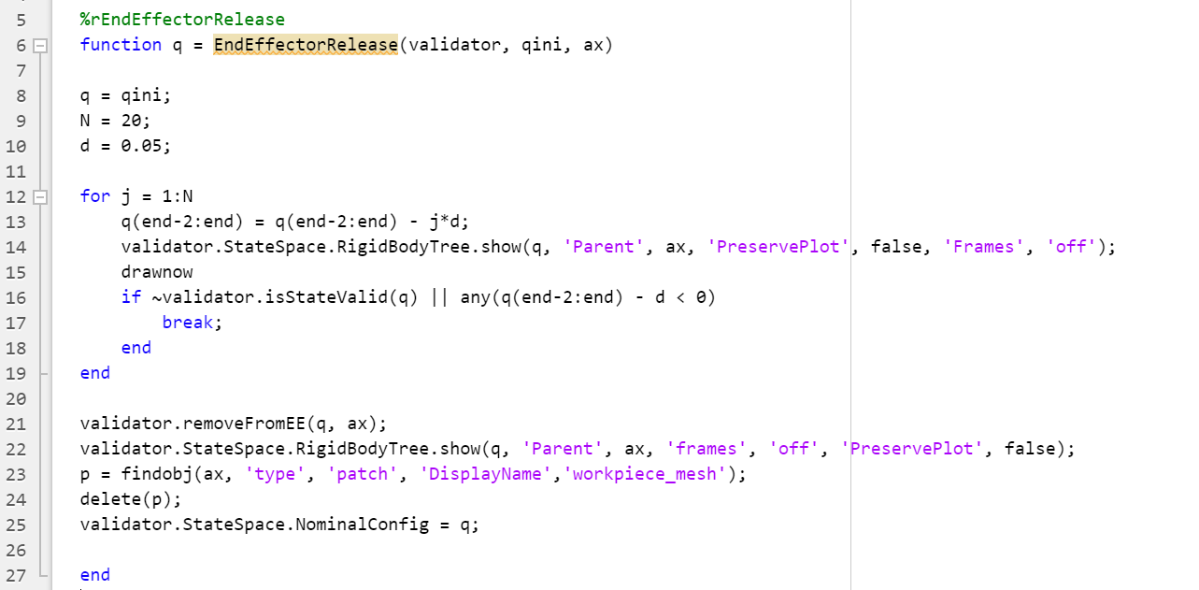
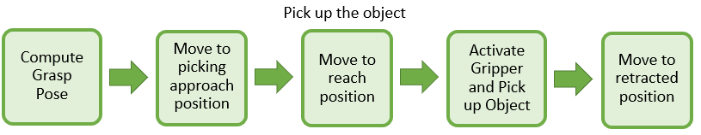
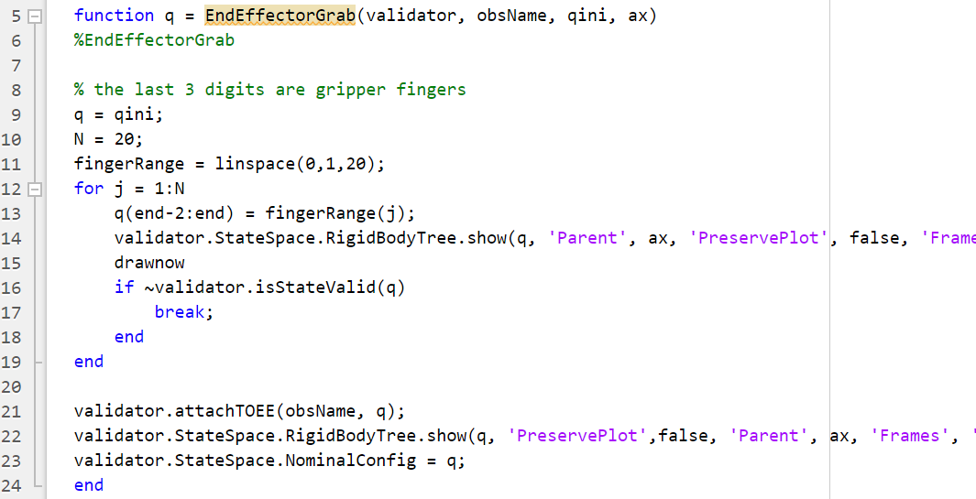
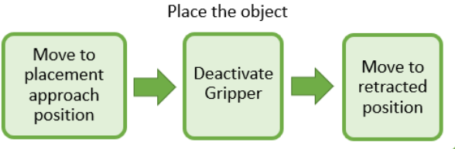
Robot Arm Grasping Motion
Environment/Arm State Space
Move Motion Plan
Grasp & Release

Slide 20
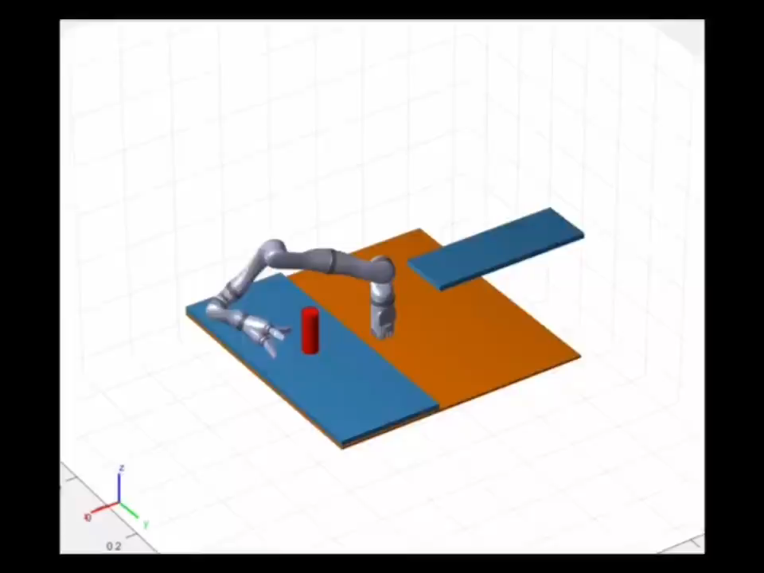
Robot Arm Motion
Adapted from: https://www.mathworks.com/help/nav/ug/motion-planning-with-rrt-for-manipulators.html

Slide 21
Thanks for Listening

